Slide 1

CAMPUS RECRUITMENT ANALYSIS
PYTHON FINAL PROJECT - GROUP 1
Nupur Agnihotri| Neelam Arya| Sunita Barik | Jingxin Yao | Zihan Huang

Slide 2






Methodology
Research Questions
Data Description
Data Preprocessing
Descriptive Analysis
Machine Learning
Recommendation

Slide 3
Research Questions
How to increase the rate of placement in the college?
How to improve a student’s academic standing to boost their confidence for placements?

Slide 4
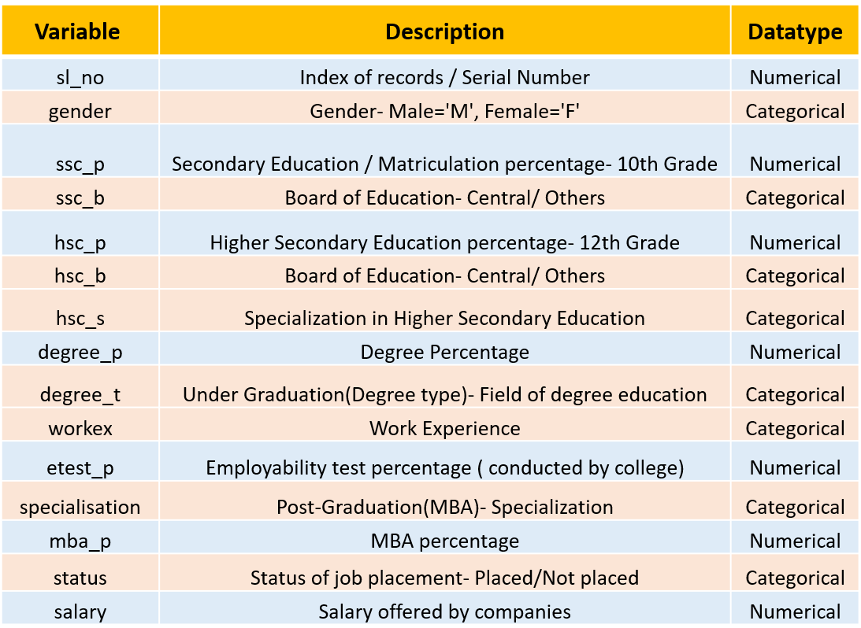

Dataset Description
The dataset is from a campus recruitment drive in an MBA college, in India. It has the credentials of all students from primary education to bachelor's and then MBA and their previous work experience.
The inputs are all the columns related to a candidate's credentials and the output column is 'status'.

Slide 5
Descriptive Analysis And Data Visualization

Slide 6
Number of columns and rows: 215 rows and 15 columns.
Missing values: Only the 'salary' column has missing values, the percentage of that is 31.26%.
Modes for all variables: It shows all the frequently occurring values in each variable.
Descriptive Analysis

Slide 7
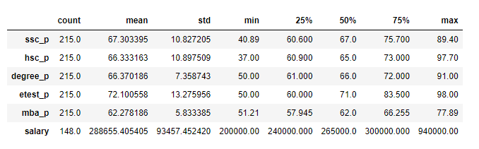
Descriptive Analysis Continued…
Descriptive statistics for all the numerical variables in the dataset:

Slide 8
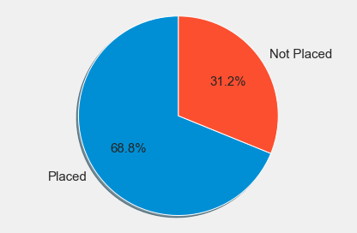
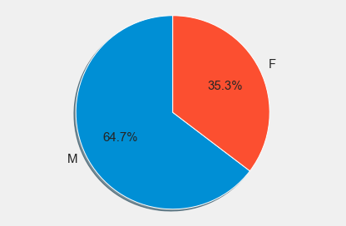
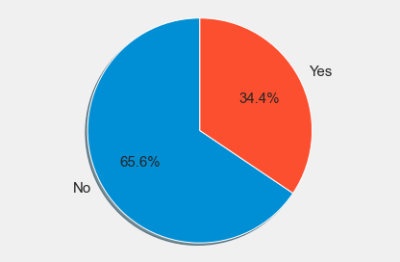
In these cases, pie charts give us an overall distribution of all students’ data based on following categorical variables: status of placement, gender and work experience.
Distribution Based on Categorical Variables
Status of placement
Gender
Work Experience

Slide 9
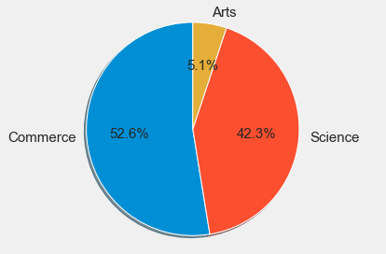
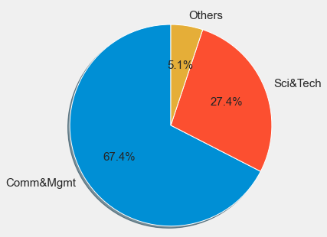
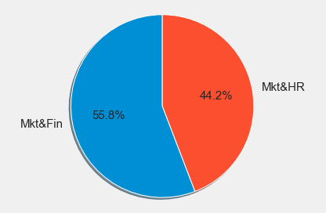
Distribution Based on Categorical Variables
Higher Secondary Education
Under Graduation
Post Graduation
In these cases, pie charts give us an overall distribution of all students’ data based on following categorical variables: higher secondary education stream, undergraduate major and post-graduation specialization.

Slide 10
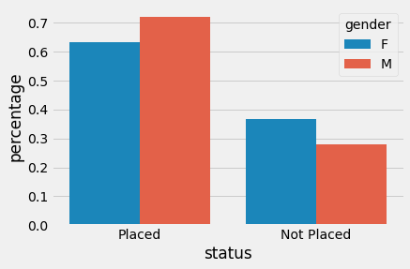
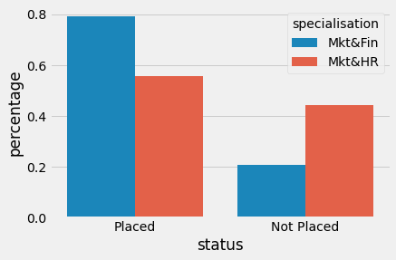
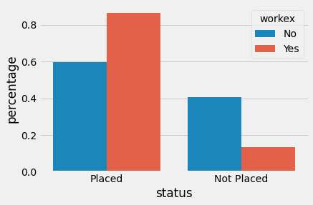
Majority of the male students got placed, whereas the percentage of placed females is lesser: 'Gender' could be a significant variable Students with work ex are preferred by the recruiters, and the difference is visually significant between these categories so this may be a significant variable Marketing & Finance MBAs are preferred over marketing & HR MBAs by the recruiters, so specialization could be significant variable
Impact of Gender, Specialization & Work-Experience on Placement

Slide 11
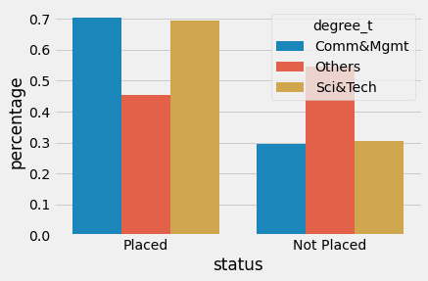
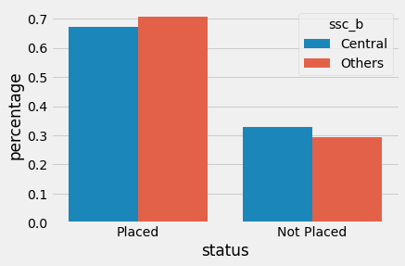
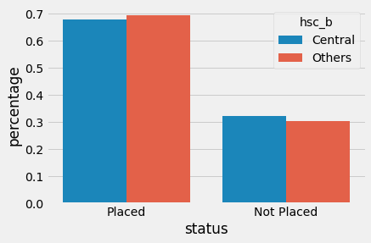
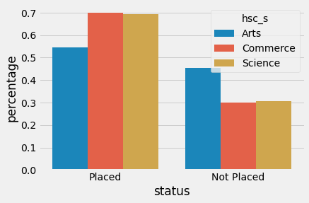
It shows that there isn't much difference of percentage within these levels of education, as the percentage of students from any of these categories are similarly placed and unplaced. So, these may not be a useful variables for classification.
Impact of Levels of Education on Placement

Slide 12
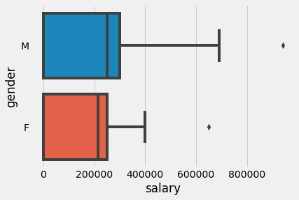
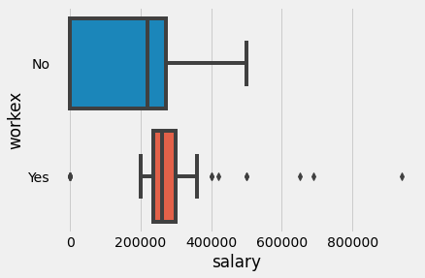
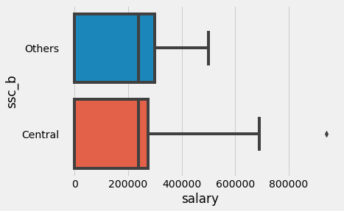
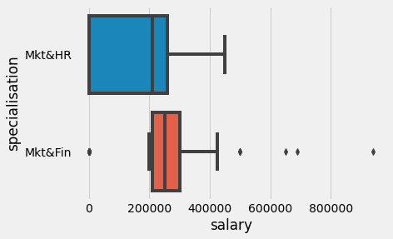
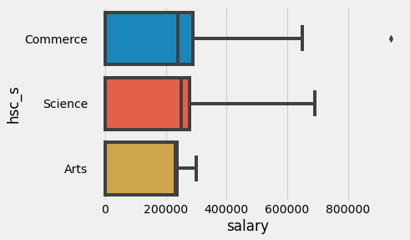
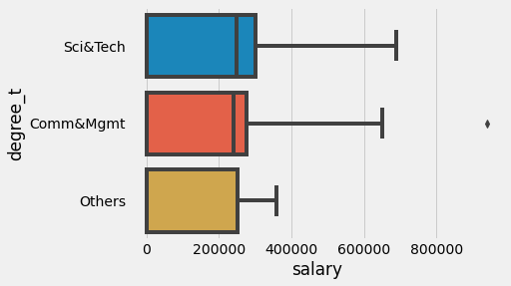
Male students are offered better salaries than females Students with work ex are offered better salaries Board of education and high school streams have no impact on placement and salaries Marketing & Finance students are offered better salaries Science and commerce degree students are offered better salaries
Salary Distribution

Slide 13
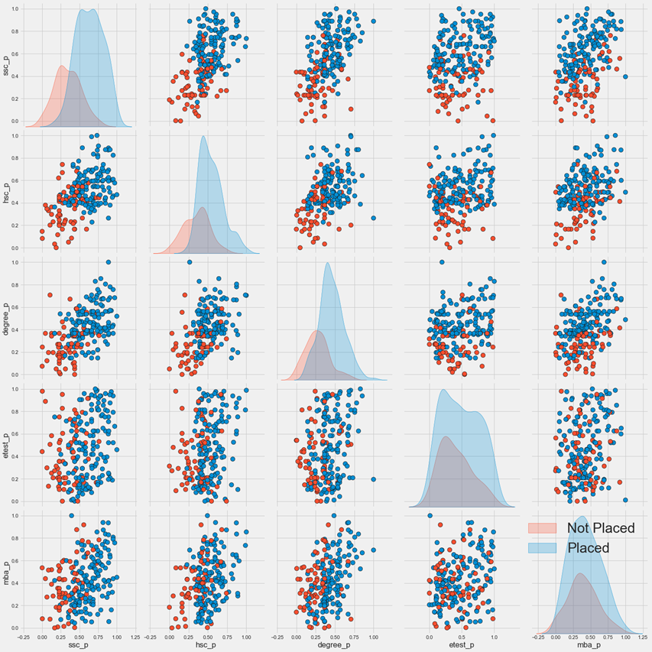
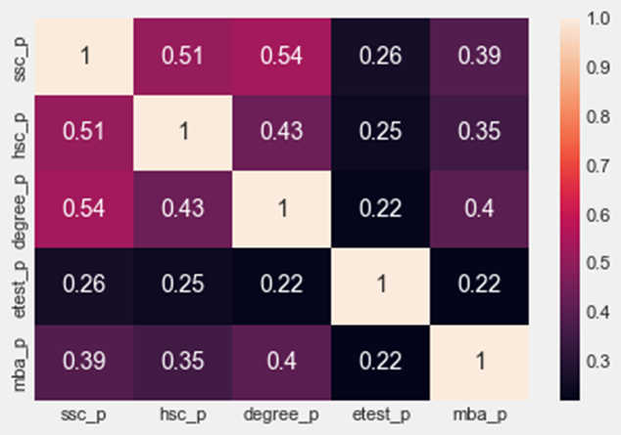
Correlation B/W Variables
As the correlation matrix graph depicts, it is possible that percentile of ssc has a strong association with the percentile of degree and that of hsc. We could make a hypothesis that they might influence a student’s placement status significantly.

Slide 14
Data Preprocessing And Model Fitting

Slide 15
Data Preprocessing
Identified numerical and categorical variables
Dropped zero variance numerical variables
Dropped high cardinality categorical variables (I.e.,- sl_no)
Missing Data Analysis: Students not-placed had missing salaries, so we imputed ‘zero’ for salaries
Label Encoded categorical variables (Gender, ssc_b, hsc_s, Specialization, Work-Ex, Degree_t, Status)
Standardized all the numerical variables to avoid misclassifications and high collinearity

Slide 16
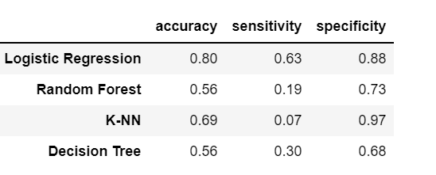
Fitting models
Defined independent variable dataset as ‘X’ and dependent variable as ‘y’
Split the dataset into 60% of training set and 40% of testing set
Fit the training dataset on following classifier models:
Random Forest Classifier
KNN Classifier
Logistic Regression
Decision Tree Classifier
Before fitting logistic regression, we checked the model summary to remove insignificant variables
We finally achieved the best accuracy of 80% with logistic regression
We plotted the ROC curve to assess the model as final measure

Slide 17
Recommendation
Setup career development or Co-op opportunities for inexperienced students
Invite more companies for arts students
For students with lower SSC and HSC percentages, university can provide some fundamental academic courses to get them prepared for more advanced courses

Slide 18
Limitation of the Dataset
Smaller Dataset: Larger the number of records, the better the model would be
Two specializations merged in one: Break down the two specializations, Mkt&Fin and Mkt&HR, into Marketing, Finance, and HR separately, to understand their independent contributions
Years of Experience: Provide years of experience for every student

Slide 19



